Slide 1


SIMATS ENGINEERING
SAVEETHA INSTITUTE OF MEDICAL AND
TECHNICAL SCIENCES
Capstone project presentation
CSA5115 - CRYPTOGRAPHY AND NETWORK SECURITY
Secure Password Manager with
Multi-Factor Authentication
Presented by:
N.S.V.L. Kavya - 192373036
K Tejaswi Reddy - 192371036
K. Lahari Reddy - 192411164
P. Pragna - 192321061
Guided By:
Dr. T. Sangeetha

Slide 2
INTRODUCTION
• Modern users manage many online accounts and need a practical way to store and protect multiple credentials.
• Password-only authentication is vulnerable to password theft, guessing, phishing, and password reuse.
• A password manager centralizes credentials, but the password vault itself becomes a high-value target.
• Multifactor Authentication (MFA) adds a second verification step before protected access is granted.
• The proposed system combines secure password management, OTP-based MFA, and audit logging.
• The project applies cryptography and network-security principles to a practical software application.
1

Slide 3
ABSTRACT
• The Secure Password Manager with Multi-Factor Authentication is a web-based application for securely storing, managing, and retrieving user credentials.
• Passwords are protected before storage, while OTP verification provides an additional authentication factor during login.
• After successful primary authentication, a time-limited OTP is generated and verified before protected vault access is granted.
• The system supports password storage, retrieval, updating and deletion, together with audit logging of defined security activities.
• Functional and security-oriented tests cover registration, login, password protection, OTP verification, access control, and logging.
• The proposed solution provides stronger credential protection while remaining practical for software-only deployment.
2

Slide 4
PROBLEM STATEMENT
• Users often reuse or store passwords insecurely because remembering many unique credentials is difficult.
• Password-only authentication creates a single point of failure when credentials are stolen or guessed.
• Compromise of a password-manager account can expose several stored credentials.
• Unauthorized users may attempt to access the password vault using stolen login credentials.
• The system must securely handle authentication, credential storage, OTP verification, access control, and activity logging.
• Therefore, a password manager with an additional authentication factor is required.
3

Slide 5
OBJECTIVES
• To design a secure password-management architecture incorporating user authentication and OTP-based MFA.
• To develop a user registration and login module with input and credential validation.
• To implement secure password protection and database storage.
• To implement OTP generation, verification, expiration, and invalid-OTP handling.
• To provide authenticated password retrieval and audit logging of important activities.
• To test and evaluate security, reliability, response time, and authentication performance.
4

Slide 6
EXISTING SYSTEM
• Traditional authentication uses a username and password as the primary access mechanism.
• Conventional password managers store multiple credentials in a centralized vault protected by a master credential.
• Some commercial systems provide MFA, but authentication and recovery workflows vary across implementations.
• Basic process: User → Username/Password → Credential Verification → Password Vault Access.
• The main security concern is that compromise of the primary credential can expose the protected vault.
• The proposed system strengthens this workflow by requiring OTP verification before vault access.
DRAWBACKS -
• Password theft can directly result in unauthorized account access.
• Password reuse increases the impact of a compromised credential.
• A vault protected only by a password may remain exposed after master-password compromise.
• Weak or predictable passwords can reduce overall security.
• Limited activity logging can make suspicious access difficult to investigate.
• Additional security mechanisms can increase complexity if usability is not considered.
5

Slide 7
PROPOSED SYSTEM
• The proposed system integrates secure password management with OTP-based Multifactor Authentication.
• Working principle: User → Registration/Login → Credential Validation → OTP Generation → OTP Verification → Secure Vault.
• After successful MFA, the user can store, retrieve, update, and delete protected credentials.
• Audit logging records defined login and password-management activities.
• Invalid credentials, incorrect OTPs, expired OTPs, and unauthorized requests are rejected.
• The design provides an additional authentication barrier without requiring dedicated biometric hardware.
7

Slide 8
SYSTEM DESIGN
User
Registration / Login
Credential Validation
OTP / MFA Verification
Secure Password Vault
Protected Database
Password Retrieval & Management
Audit Logging
Primary authentication → OTP/MFA → Secure vault access → Password management → Audit logging
11

Slide 9
AUTHENTICATION & SECURITY FLOW
Enter Credentials
Validate Credentials
Generate OTP
Deliver OTP
Verify OTP
Grant Vault Access
Invalid credentials / invalid OTP / expired OTP → Access Denied or Retry
Security controls: protected credentials • OTP expiry • limited attempts • access control • audit logs
12

Slide 10
TECHNOLOGIES
• Java – core application logic and security-related processing.
• Spring Boot – backend framework for authentication, OTP verification, APIs, and business logic.
• HTML, CSS, JavaScript – web interface and user interaction.
• MySQL – database for user accounts and protected password records.
• AES-256 Encryption – used to encrypt sensitive password data where applicable.
• Git & GitHub – source-code version control, collaboration, and project management.
• Visual Studio Code – coding, debugging, and project maintenance.
13

Slide 11
METHODOLOGY
1. REQUIREMENTS Security, functional & user needs
2. SYSTEM DESIGN Architecture, database & workflow
3. AUTHENTICATION Registration, login & validation
4. CREDENTIAL SECURITY Encrypt/store protected passwords
5. MFA Generate, deliver & verify OTP
6. MANAGEMENT Retrieve/update credentials
7. AUDIT Record security events
8. TESTING Functional + security verification
14

Slide 12
MODULE 1: USER REGISTRATION
• Create a new user account through the registration interface.
• Validate required user information and authentication fields.
• Enforce password-strength rules before account creation.
• Store required user details securely in the database.
• Prevent duplicate or invalid account registration.
• Output: registered user account ready for authenticated login.
15

Slide 13
MODULE 2: PASSWORD ENCRYPTION & STORAGE
• Allow authenticated users to save credentials for different websites or services.
• Protect sensitive password values before storing them in the database.
• Use appropriate cryptographic protection and secure database access.
• Associate stored credentials with the authenticated user.
• Prevent unauthorized users from directly accessing protected vault records.
• Output: protected credential records stored in the database.
16

Slide 14
MODULE 3: OTP / MULTI-FACTOR AUTHENTICATION (MFA)
• Generate a unique 6-digit One-Time Password after successful primary authentication.
• Deliver the OTP through the configured communication mechanism.
• Verify the OTP entered by the user before granting protected access.
• Reject incorrect OTPs and prevent expired OTPs from being accepted.
• Limit repeated verification attempts to reduce OTP guessing attacks.
• Output: successful MFA verification or access denial.
17

Slide 15
MODULE 4: PASSWORD RETRIEVAL & AUDIT LOGS
• Retrieve saved credentials only after successful authentication and MFA.
• Display or manage protected credentials through the password vault interface.
• Support password additions, updates, and deletions.
• Record login history and defined authentication events.
• Track password-management activities for accountability.
• Output: controlled credential access with an auditable activity trail.
18

Slide 16
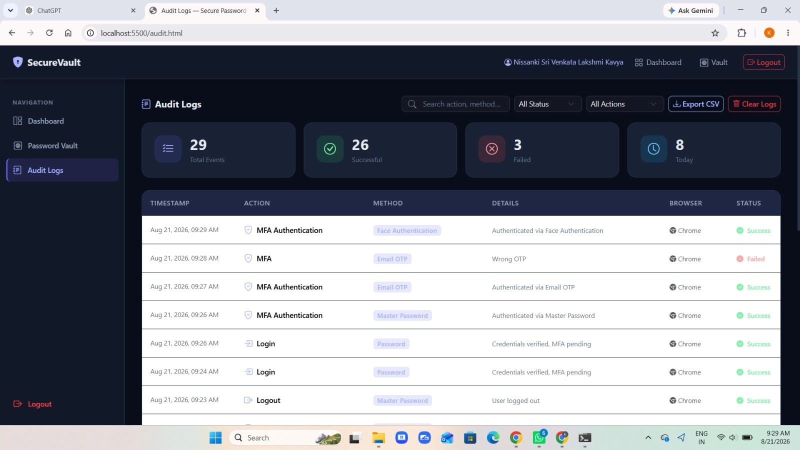
RESULTS & DISCUSSION
• Successful primary authentication confirms that the registration and login workflow operates as intended.
• OTP testing verifies handling of valid, invalid, and expired verification codes.
• Protected credential storage reduces exposure of sensitive password data compared with plaintext storage.
• Access-control testing demonstrates that protected vault functions depend on successful authentication and MFA.
• Audit logs provide traceability for defined authentication and password-management activities.
• Response time depends on application processing, database operations, and network/OTP delivery conditions.
19

Slide 17
CONCLUSION & FUTURE SCOPE
• The project developed a secure password-management solution combining credential protection with OTP-based MFA.
• The architecture addresses the weakness of relying only on a password for access to a high-value credential vault.
• The four modules provide registration, protected storage, MFA verification, password management, and auditability.
• Functional and security-oriented testing provides evidence for authentication, OTP, access-control, and storage requirements.
• Future work includes biometric authentication, authenticator-app support, password-strength analysis, breach monitoring, browser/mobile integration, and suspicious-login detection.
• The proposed system provides a practical software-based foundation for stronger personal credential security.
21

Slide 18
REFERENCES
[1] M. Jubur, P. Shrestha, and N. Saxena, “An in-depth analysis of password managers and two-factor authentication tools,” ACM Computing Surveys, 2025.
[2] A. Fábrega et al., “Exploiting leakage in password managers via injection attacks,” Proc. USENIX Security Symposium, 2024.
[3] S. Amft et al., “We’ve disabled MFA for you: An evaluation of the security and usability of multi-factor authentication recovery deployments,” ACM CCS, 2023.
[4] N. Huaman et al., “Passwords to-go: Investigating multifaceted challenges for password managers in the Android ecosystem,” ACSAC, 2024.
[5] S. Klivan et al., “Exploring credential management strategies and obstacles during password manager setup,” SOUPS, 2023.
[6] National Institute of Standards and Technology, “Digital Identity Guidelines: Authentication and Authenticator Management,” NIST SP 800-63B-4, 2025.
[7] OWASP Foundation, “OWASP Application Security Verification Standard (ASVS),” Version 5.0.0, 2025.
[8] D. M’Raihi et al., “TOTP: Time-Based One-Time Password Algorithm,” RFC 6238, IETF, 2011.
22

Slide 19
THANK YOU

